Slide 1
Coaching for Addiction Recovery Enhancement (CARE)
Treatment Progress Assessment (TPA8)
Patient Monitoring Tool: Training 1

Slide 2
What is the Treatment Progress Assessment (TPA8)?
The Treatment Progress Assessment-8 (TPA8) monitors:
SUD symptom severity
Treatment progress indicators associated with clinical outcomes and relapse
Development of a measure was recommended by a stakeholder group of insurers and addiction treatment providers as part of quality metrics discussions because:
No obvious validated measure was available for use in SUD clinics
Measures were needed that better reflected the patients’ voice
Short, valid, and easy to administer tools were needed
The Treatment Progress Assessment-8 (TPA8) was co-developed by Center on Addiction and OASAS
The validated assessment tool, PHQ9 for depression, was used as a model for TPA8 development.

Slide 3
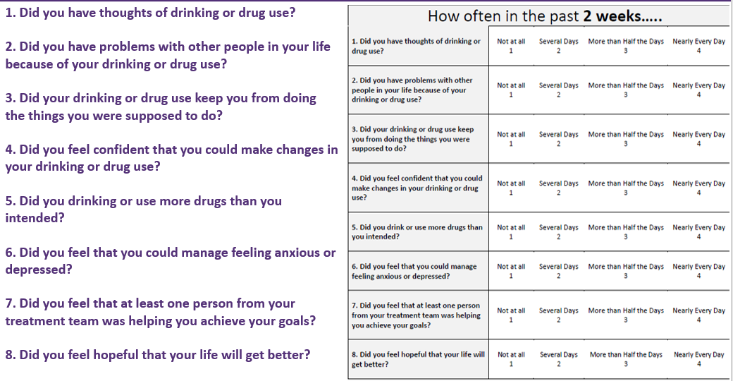
The TPA measures items over the past 2 weeks

Slide 4
Symptoms Subscale
Items measuring SUD symptoms were inspired by DSM-V criteria and include:
Cravings (TPA8 Q1)
Social Consequences (TPA8 Q2)
Role Consequences (TPA8 Q3)
Loss of Control (TPA8 Q5)

Slide 5
Cravings (TPA8 Q1)
How often in the past 2 weeks did you have thoughts of drinking or drug use?
Importance of cravings:
Can be an early signal of whether someone is struggling to meet their treatment goals
Strategies for addressing cravings:
Medication
If not on medication: Consider for opioid or alcohol use disorder
If on medication: Consider adjustments to dosage or formulation
Cognitive behavioral therapy
Skill building
Urge surfing: learning process for putting off action when peak craving hits and that the craving will naturally reduce
Distraction
Mindfulness

Slide 6
Social Consequences (TPA8 Q2)
How often in the past 2 weeks did you have problems with other people in your life because of your drinking or drug use?
Importance of social consequences:
Key indicator of functioning and impairment
Determining if the consequences were from current or past use will help to guide how to respond
Strategies for addressing social consequences:
Discuss relationship management and social support available
Offer peer support services
Skill building
Social/interpersonal skills
Couple and/or family therapy
Self-help/mutual help groups (AA, NA, SMART recovery)
Connect to a Recovery Center
Notes:
about things like obeying laws and meeting your responsibilities to society: Do your actions have positive or negative impacts on other people
I have spent too much or lost a lot of money because of my drinking or drug use
I have failed to do what is expected of me because of my drinking or drug use
My family has been hurt by my drinking or drug use
I have had money problems because of my drinking or drug use
A friendship or close relationship has been damaged by my drinking or drug use
My drinking or drug use has damaged my social life, popularity, or reputation
I have gotten into trouble because of drinking or drug use (SOC)
The quality of my work has suffered because of my drinking or drug use

Slide 7
Role Consequences (TPA8 Q3)
How often in the past 2 weeks did your drinking or drug use keep you from doing the things you were supposed to do?
Importance of role consequences:
Key indicator of functioning and impairment
Determining if the consequences were from current or past use will help to guide how to respond
Strategies for addressing role consequences:
Discuss role management and social supports available
Offer peer support services
Skill building
Conflict management
Communication skills
Anger management
Couple and/or family therapy
Process-oriented groups
Harm reduction
Notes:
about things like obeying laws and meeting your responsibilities to society: Do your actions have positive or negative impacts on other people
I have spent too much or lost a lot of money because of my drinking or drug use
I have failed to do what is expected of me because of my drinking or drug use
My family has been hurt by my drinking or drug use
I have had money problems because of my drinking or drug use
A friendship or close relationship has been damaged by my drinking or drug use
My drinking or drug use has damaged my social life, popularity, or reputation
I have gotten into trouble because of drinking or drug use (SOC)
The quality of my work has suffered because of my drinking or drug use

Slide 8
Loss of Control (TPA8 Q5)
How often in the past 2 weeks did you drink or use more drugs than you intended?
Importance of loss of control:
Key indicator of addiction severity and indicator of risk of harm
Strategies for addressing loss of control:
Discuss role management and social supports available
Offer peer support services
Cognitive behavioral therapy
Skill building
Urge surfing: learning process for putting off action when peak craving hits and that the craving will naturally reduce
Distraction
Mindfulness
Overdose prevention
Harm reduction
Consider higher level of care
Notes:
about things like obeying laws and meeting your responsibilities to society: Do your actions have positive or negative impacts on other people
I have spent too much or lost a lot of money because of my drinking or drug use
I have failed to do what is expected of me because of my drinking or drug use
My family has been hurt by my drinking or drug use
I have had money problems because of my drinking or drug use
A friendship or close relationship has been damaged by my drinking or drug use
My drinking or drug use has damaged my social life, popularity, or reputation
I have gotten into trouble because of drinking or drug use (SOC)
The quality of my work has suffered because of my drinking or drug use

Slide 9
Treatment Processes Subscale
Items measuring treatment progress include:
Self-Efficacy (TPA8 Q4)
Emotion Regulation (TPA8 Q6)
Therapeutic Alliance (TPA Q7)
Hopefulness (TPA Q8)

Slide 10
Self-Efficacy (TPA8 Q4)
How often in the past 2 weeks did you feel confident that you could make changes in your drinking or drug use?
Importance of self-efficacy:
Self-efficacy has a predictive relationship with SUD treatment outcomes, such as retention, engagement, and substance use.
Strategies for addressing self-efficacy:
Cognitive Behavioral Therapy
Self-talk coaching, functional analysis
Self-help/mutual help groups (AA, NA, SMART recovery)
Peer support services
Connect to Recovery Center
Reframe what is perceived as past failures – find successes

Slide 11
Emotion Regulation (TPA8 Q6)
How often in the past 2 weeks did you feel that you could manage feeling anxious or depressed?
Importance of emotion regulation:
Impairment in emotion regulation is thought to a major antecedent of alcohol/drug use
Associated with poorer treatment outcomes among individuals with SUD
Strategies to address emotion regulation:
Cognitive behavioral therapy
Skill building
Emotional regulation and distress tolerance
Psychiatric assessment and treatment for mental health (i.e., psychotherapy, medications)
Trauma-informed environment and trauma-focused therapy
Suicide risk assessment, monitoring, and intervention

Slide 12
Therapeutic Alliance (TPA8 Q7)
How often in the past 2 weeks did you feel that at least one person from your treatment team was helping you achieve your goals?
Importance of therapeutic alliance
Has a predictive relationship with SUD treatment outcomes, such as retention, engagement, and substance use
Ways to address therapeutic alliance
Providing person-centered care—incorporating patient preferences in goal setting and fostering therapeutic alliance has been posited as a way to improve patient outcomes and satisfaction
Using shared decision-making for treatment decisions including medications
Trauma-informed treatment environment
Peer support services

Slide 13
Hopefulness (TPA8 Q8)
How often in the past 2 weeks did you feel hopeful that your life will get better?
Importance of hopefulness
Research suggests that interventions to improve hope are heavily favored among SUD treatment counselors
Feelings of hopefulness are related to better treatment and recovery outcomes.
Strategies to address hopefulness
Providing person-centered care—incorporating patient preferences in goal setting and fostering therapeutic alliance has been posited as a way to improve patient outcomes and satisfaction
Trauma-informed treatment environment
Peer support services
Cognitive behavioral approach, reframing, self talk coaching

Slide 14
Electronic Version of TPA8
Benefits include:
Easy to administer to clients to save staff time
Automates calculations of patient progress scores
Creates reports that are shared with the clinical team to make measurement driven decisions about client care
Administration:
Clients can complete within the clinic on a tablet
Clients can complete via mobile phone on their own time through text-based system
In the next TPA8 training, we will further describe the electronic systems to complete and manage the TPA8 in your clinic
Notes:
megan

Slide 15
Next
In the next training we will review further:
The electronic version of the TPA8 (the eTPA8)
The staff interface and available reports
How the eTPA8 might be implemented in your clinic

Slide 16
Coaching for Addiction Recovery Enhancement (CARE)
Treatment Progress Assessment (TPA8)
Patient Monitoring Tool: Training 2

Slide 17
Electronic Version of TPA8 (eTPA8)
In this training, we will describe the electronic systems to complete and
manage the TPA8 as well as how this system might work in your clinic
The electronic system:
Has 2 ways for clients to complete the eTPA8: on a tablet in the clinic or through a text-based system on their mobile phones
Automates calculations of patient progress scores
Creates reports that are shared with the clinical team to make measurement driven decisions about client care

Slide 18
Electronic TPA8
Notes:
Upon opening the eTPA8 website on a tablet, this login screen would be the first screen to appear. This screen asks staff to login with their email and password so that clients can access the TPA8 questions. Staff do not have to login every time a client needs to complete the eTPA8, as the staff member will stay logged in for a period of time.
Staff member will have to log into the system before a client can begin the assessment.

Slide 19
Welcome Screen
Notes:
The welcome screen will appear once a staff member has logged in. This is when you would hand the tablet to the client so that they could proceed with completing the TPA8 questions. The client would just need to click the purple “get started’ button to move ahead.

Slide 20
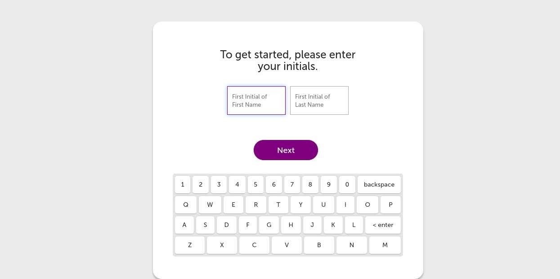
Get Started Screen
Notes:
This brings the client to a screen that asks them to enter the first initial of their first name and first initial of their last name.

Slide 21
Social Security
Notes:
The client then is asked to enter the last 4 numbers of their social security number. We ask for the client’s initials and last 4 numbers of their social security because this information connects all of their assessments with the reporting system. This allows us to track a client’s scores over time while avoiding the hassle of a client needing to remember a login and password each time they completed the eTPA8.

Slide 22
Login Error
Notes:
If the information that the client enters was not correct, this screen would pop up and the client would have a chance to re-enter information starting from the initials screen. A client must have an account in the system that clinic staff set up for them to be able to proceed. If they don’t have an account in the system, this screen would also pop up.

Slide 23
Assessment Start
Notes:
Now that the client has entered their information so that we can track their scores over time, they get started with the questions. This screen reminds clients that we are interested in their feelings and experiences over the past 2 weeks. If they click next, it will bring them to the first TPA8 question.

Slide 24
First Question
Notes:
This is what each TPA8 question screen looks like. Clients would click on one of the 4 response options: not at all, several days, more than half the days, or nearly every day. Once clients click on their answer, the system automatically move onto next question, so that there is no need to click to move ahead. This allows clients to move fairly quickly through the questions. There is the option to skip a question if the client does not want to answer a specific question. There is also a back arrow if client wants to see a question again or change their answer. Finally, on the bottom left, clients can see which question they are on in the tracking bar.

Slide 25
Completed Assessment
Notes:
Once clients answer each of the 8 questions, they will come to this screen where they can click yes to submit their answers. If they select no, it will take them back to the last TPA8 question and they will be able to review and change their answers.

Slide 26
Post Assessment
Notes:
If a client clicks “yes” to submit their answers, they will come to the “thank you” screen and clicking “ok, got it” ends the assessment for them and brings the tool back to the beginning so that the next client can take the assessment.

Slide 27
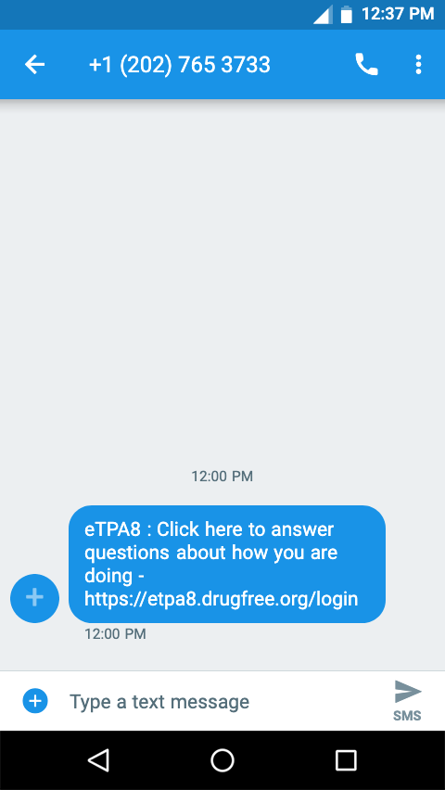
Text-based Version
Notes:
In the previous screens, we have been viewing what the eTPA8 looks like on a tablet. If clients opt to receive text messages so that they can complete the TPA8 while they aren’t in the clinic, they would receive a text message to prompt them to complete the assessment. This is an example of the kind of text they would receive. If they click on the website link in the text message, they will be brought to the Welcome screen. The only difference between the phone version and the tablet version of the TPA8 is that the phone version displays vertically which is better for phone administration. Also, the plant images would not display given the small size of the phone screen as compared to the tablet screen.

Slide 28
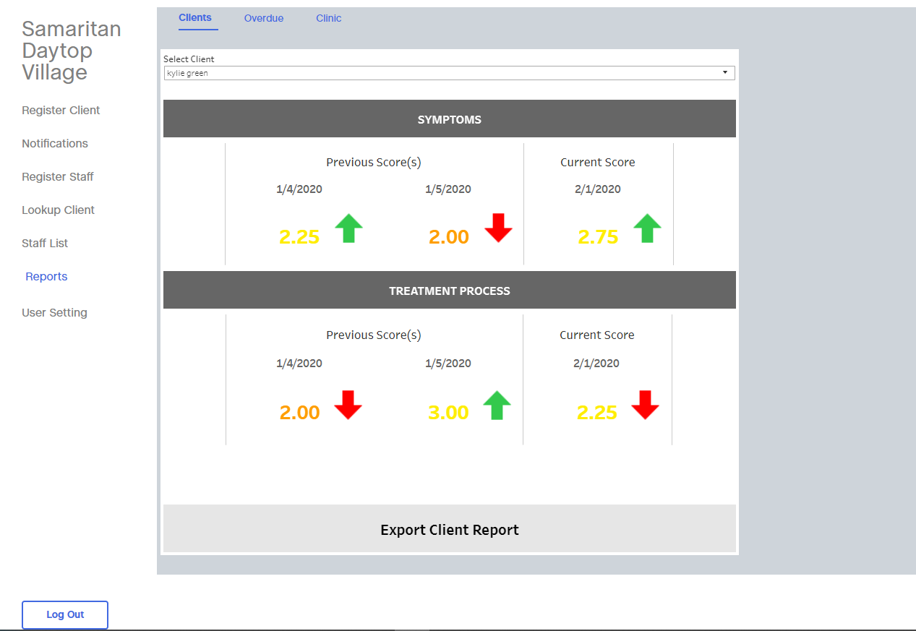
System Reports (1 of 3)
Symptoms and treatment processes subscales
Displays change in score over past 3 administrations
Notes:
This screen shows an example of a report that will be available to staff for each client. You may recall from the first TPA8 training that there are 2 main sections of the TPA8: Symptoms and Treatment Process. With 4 questions that make up each section. The report displayed here shows on the top half the information about symptoms and on the bottom half of the screen the information about treatment progress. For each, you can see the past 3 scores for each, with the current score on the right and the previous 2 scores to the left. You can see the dates for them as well. The Arrows give a quick visual as the score has gotten worse or better. Green indicates the client had a better score since last administration, red means the score got worse. If we look at the example of the symptoms here you can see that the most current score was a 2.75 which was better (higher is better) than the previous score from a month earlier.
Remember that these reports combine the 8 questions of the TPA8 into 2 main components. If you want to see the pattern of client responses for each question, you will also have access to that information by clicking on either the symptoms bar or the treatment process bar on the screen.

Slide 29
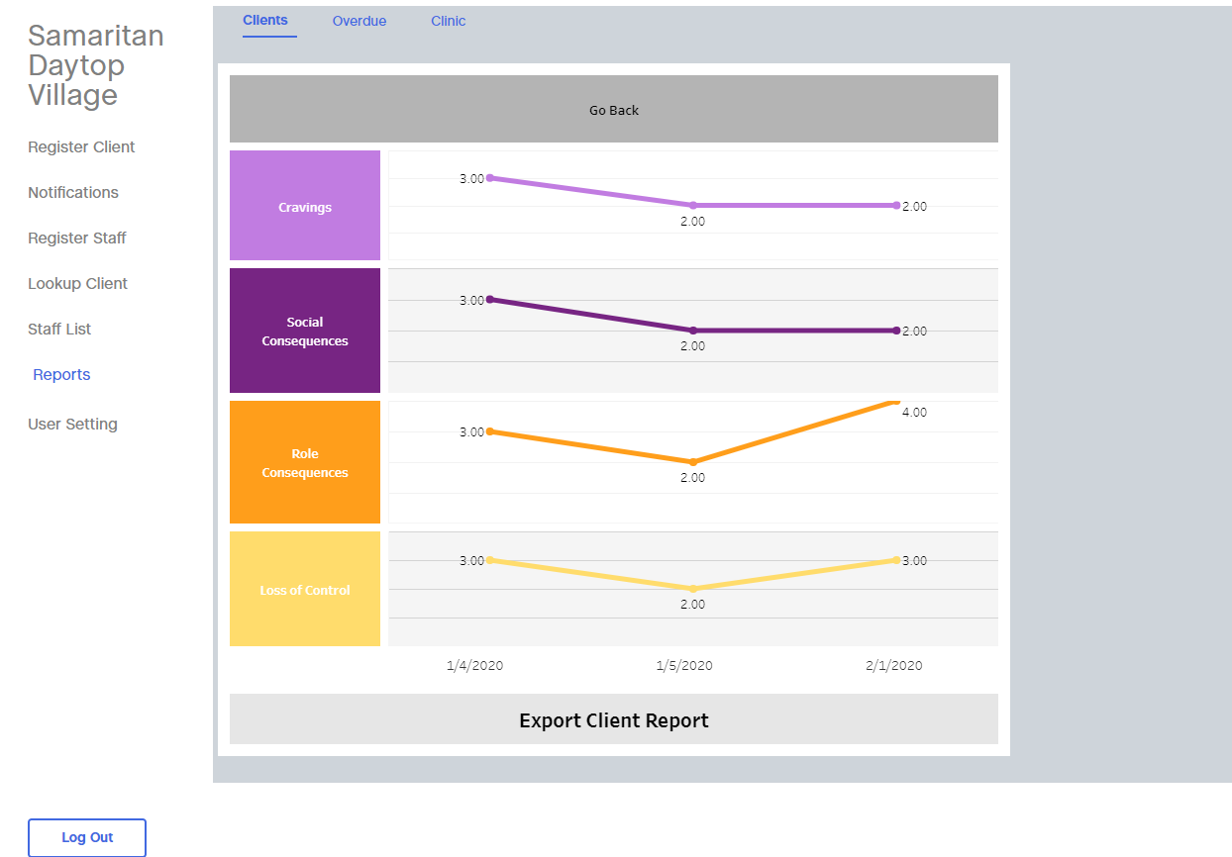
System Reports (2 of 3)
Individual Item Scores
Displays change in score over past 3 administrations for each question
Notes:
If you clicked on the symptoms bar on the previous screen, it would bring you to this screen where you can see each of the symptoms items and the past 3 scores on a line graph. For example, if you look at the top line, that represents scores on the cravings item over the past 3 administrations. You can see the dates of each along the bottom.

Slide 30
System Reports (3 of 3)
Notes:
Similarly, if you clicked on the treatment process bar on the earlier report screen, you would find those 4 items here. You will notice that on the bottom there is an options to export these reports into a pdf so that you can save or print the report information.

Slide 31
Overdue Reports
Notes:
Besides the reports, there are a few other features to point out. For example, you will be able to see which clients are overdue for completing their TPA8 by viewing this overdue reports screen. You can see when the last TPA8 was submitted by the client as well as when the next one is due.

Slide 32
Management System for Staff
Notes:
To access the reports we just reviewed as well as the rest of the electronic management system, staff would log in and would land on this page. Along the left you can see different options that staff can click to complete different tasks within the system. We will briefly walk through these now.

Slide 33
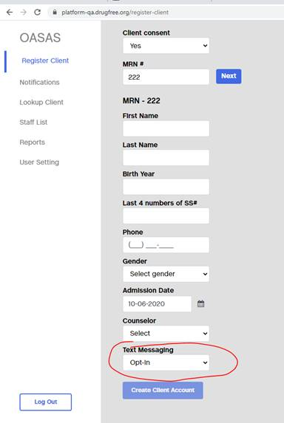
Client Registration
Notes:
In order for a client to be able to complete the eTPA8, they will need to be registered in the system. Registration can be accomplished by clicking on the “register client” tab. You must 1st obtain the consent form from the client.
Then you enter the information requested, such as the medical record number, name, last 4 numbers of the social security, phone number, gender, admission date and their counselor. In the red circle you can see that this is where you will be able to opt clients in to receive the text messages to complete the eTPA8. If you have their info, this process takes < 5 minutes
Clients may not want to receive texts or use their phone to complete this, so it is ok if they do not opt in. You will want to confirmed with clients whether they want to receive texts so that you can accurately identify their preference here.

Slide 34
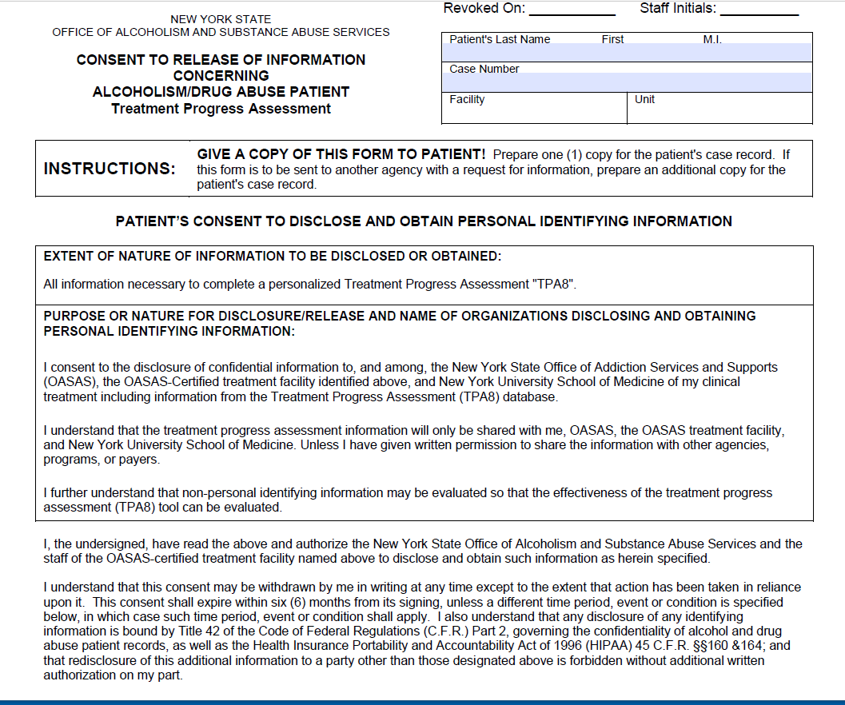
A note about client Consent/Release of Information
When clients are added to the system, you will be asked whether they have given consent (Yes/No)
Due to privacy laws, clients will need to complete a release of info form because NYU and OASAS will receive data through the TPA8 system
Notes:
Here is an example of the release form. This should look familiar as it is a form used for other OASAS functions. Signing this form just allows the client to give permission for the TPA8 data to be shared with project partners such as OASAS and NYU.

Slide 35
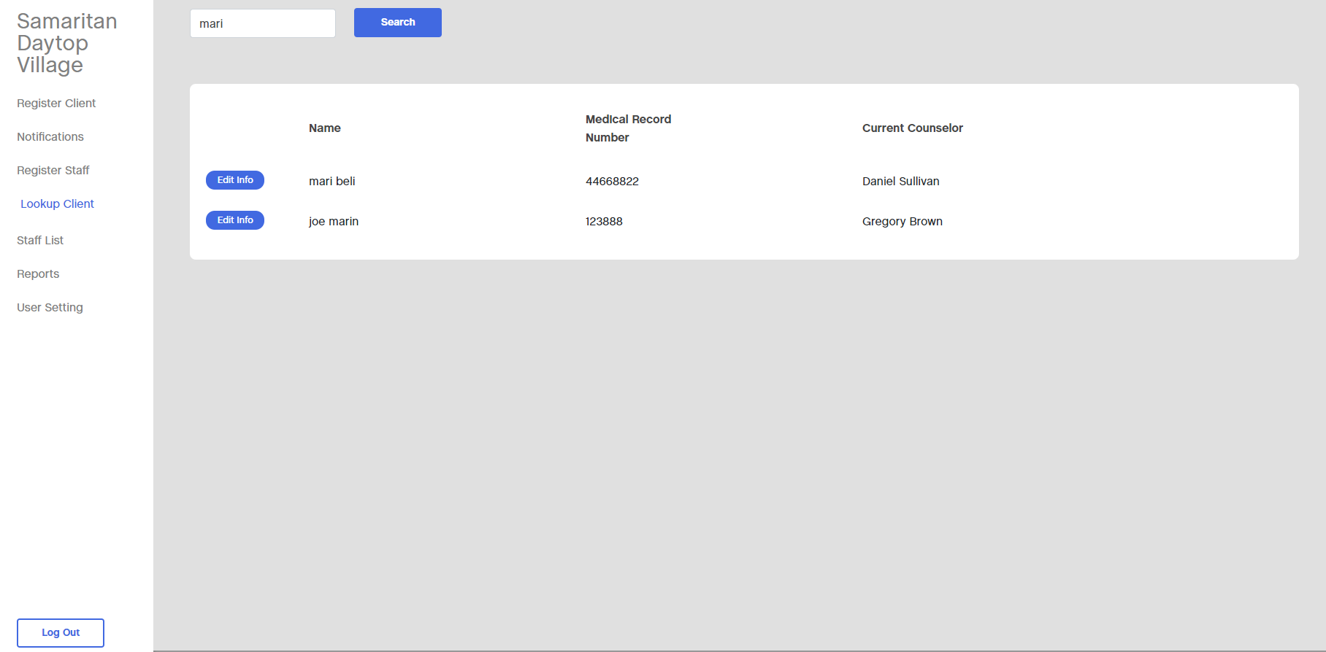
Lookup Client
Notes:
Another option in the system is a client ‘look up’. This just allows you to find a client in the system.
You can either type the clients name to find that client. OR just CLICK SEARCH and all the clients will pop up.
click the blue “edit” button to edit their personal information, for example if their phone number changed.

Slide 36
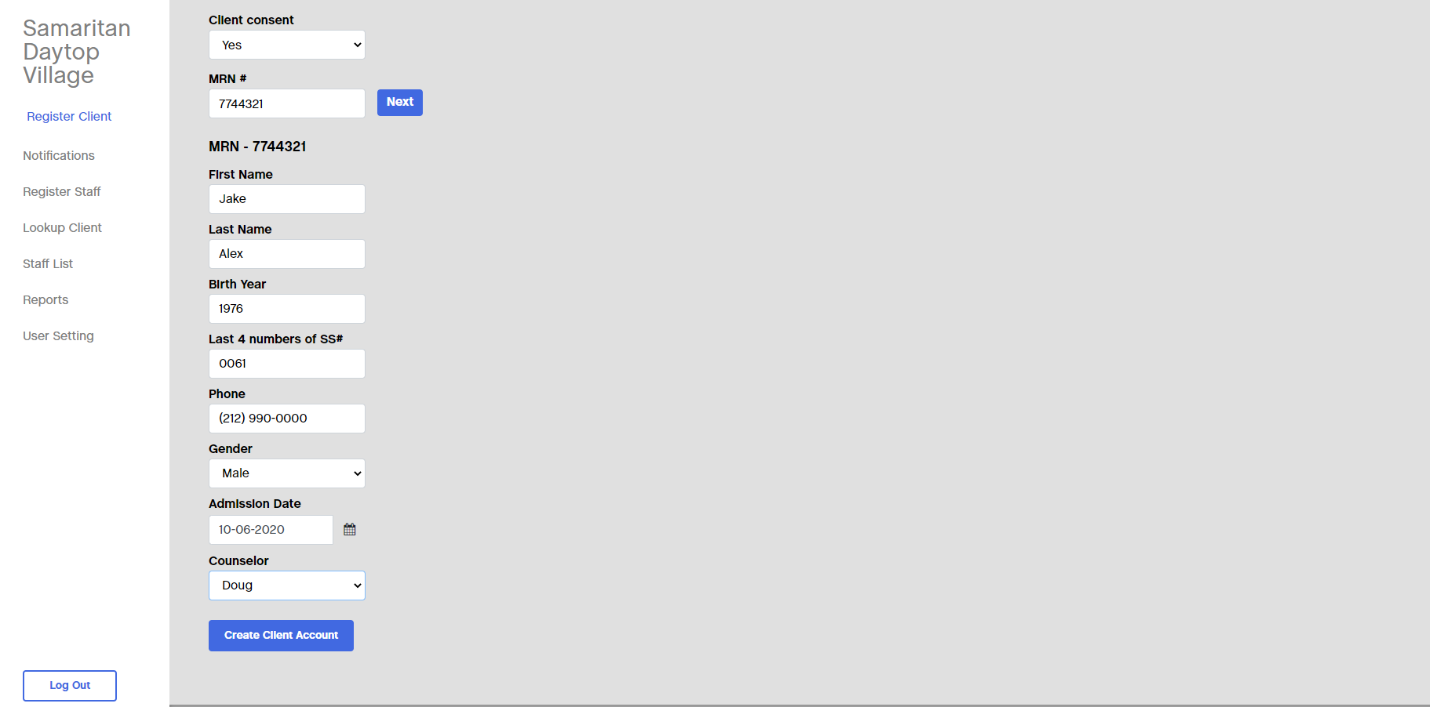
Edit Client Info
Notes:
If you click edit, it will bring you to this information entry screen so you can edit the client information.

Slide 37
Implementation of the eTPA within your clinic (1 of 3)
The eTPA8 is meant to be completed regularly by clients
We suggest every 2 weeks so that you can closely monitor their care
You will have access to a report that shows you the client’s result
Each clinic works a little differently
The CARE study team will work closely with your clinic to ensure that you can implement the TPA8 in a way that best works with your clinic set-up and workflow
The CARE study will provide each clinic with tablets so clients can complete the eTPA8
Clients can also complete outside the clinic on their mobile phone if you select that option in the system
The staff system can be accessed on any computer with internet connection
Notes:
We want the eTPA8 to be as useful as possible for your clinic and know that each clinic might work a little differently. For this reason, the study team will work closely with your clinic to help implement the eTPA8 in a way that best works with your clinic set up and workflow.
The study will provide each clinic with a set of tablets so clients can complete the eTPA8 in your clinic. And remember that clients can also use their mobile phone if they opt to, which might be useful if they are not coming into the clinic in person very frequently.
The staff side of the system can be accessed on any computer with internet access. You will be provided with the website to access this system.

Slide 38
Implementation of the eTPA within your clinic (2 of 3)
Now, let’s walk through the steps of how this system works for your clients
Step 1: As a new client enrolls in treatment in your clinic, you or a designated staff person in your clinic would
ensure they have completed the consent form
add them to the system by entering their information
Designate whether they will receive text reminders to complete the eTPA8
Step 2: The client will then have the option to start completing the eTPA8 on the clinic-based tablets, and if receiving texts, they will immediately receive a text to complete their first eTPA8 on their phone.
Notes:
Now, to really bring the eTPA8 to life for you, we will walk through an example of how this might work.

Slide 39
Implementation of the eTPA within your clinic (3 of 3)
Step 3: Prior to your client meetings, you can view their individual reports so that you can discuss recent changes in their scores and make changes to treatment plan as needed
Step 4: The client will continue to complete the eTPA8 in the clinic on the tablet or via the text-message based system every 2 weeks
Step 5: You will continue to have access to reports and will receive regular email messages once reports are available

Slide 40
Next Steps
The clinic champions and change team will:
receive additional training on the system
create an implementation plan
The CARE study team will provide:
Tablets for use in your clinic
Implementation support and technical assistance
An eTPA8 user manual
Notes:
Now that you have learned about the TPA8 and the electronic systems that support it, we will begin to work with your clinic to implement this so that it works well for your clinic set up. For the CARE project, there are designated clinic champions and a change team that will learn about the system in a more in depth way and create an implementation plan. As a reminder, the study team will provide you with tablets to use in your clinic. The study team will also provide you with implementation support and ongoing technical assistance and a manual to guide you.
Thank you, that concludes this training. We look forward to working with you to implement the eTPA8 to support the important work you do.

